Slide 1
Math 769: Statistical Learning

Slide 2
What are Basis Expansion Methods?
Shahrzad Jamshidi, PhD

Slide 3
Last Module
We discussed Classification.
Three metrics: Accuracy, Precision, and Recall.
Three methods: Linear Regression, Linear Discriminant Analysis (LDA), and Logistic Regression.

Slide 4
Objectives
Describe Basis Expansion.
List the advantages and the disadvantage of basis expansion methods.

Slide 5

Introduction
Basis expansion methods are our first methods that move beyond linearity.
Core idea: replace or augment $X$ with transformations of $X$; then use linear models.

Slide 6
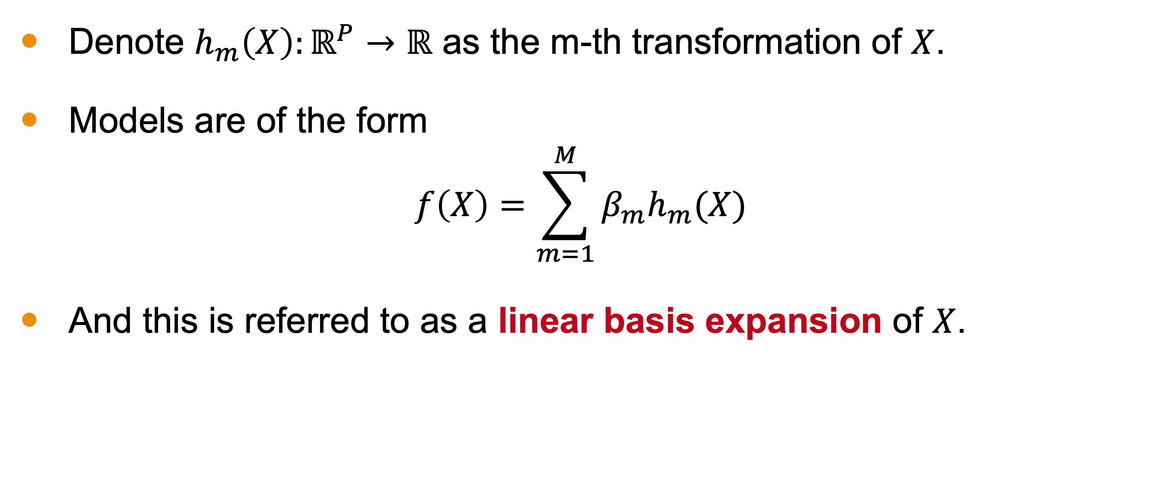
Mathematics
Denote $h_{m}\left(X\right):ℝ^{P}→ℝ$ as the m-th transformation of $X$.
Models are of the form
$$f\left(X\right)=\sum_{m=1}^{M}{{β_{m}h}_{m}(X)}$$
And this is referred to as a linear basis expansion of $X$.

Slide 7
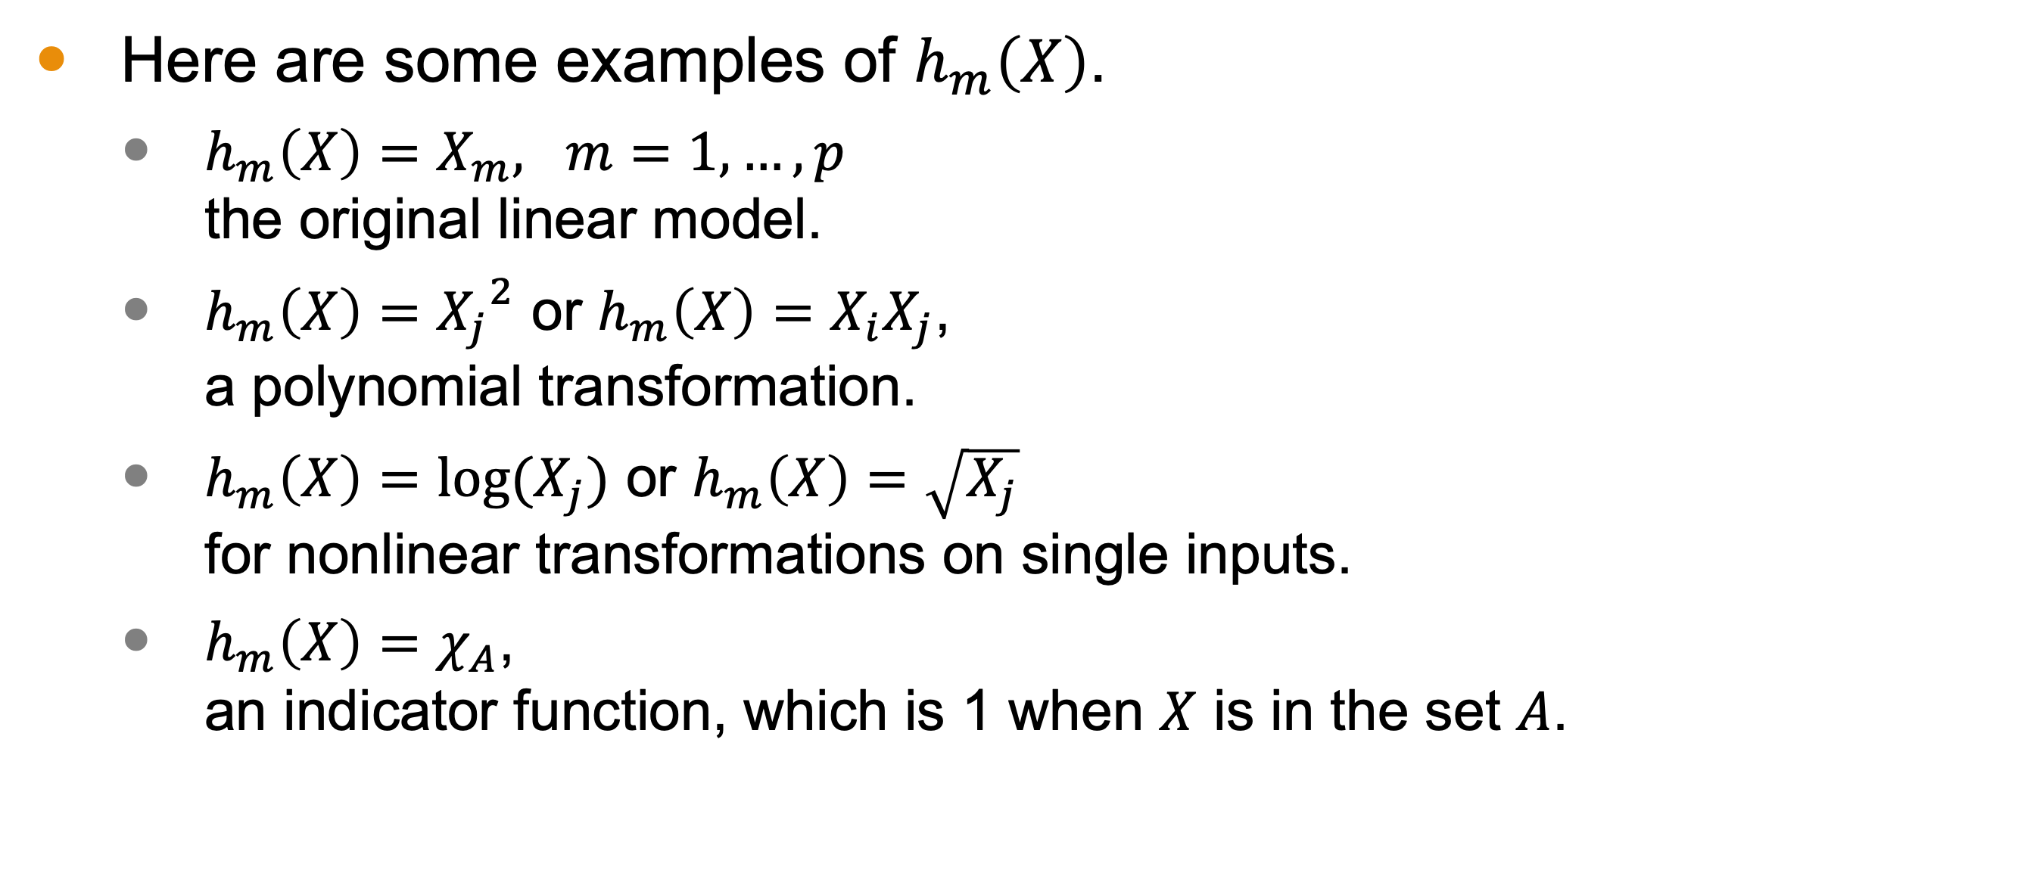

Examples of $h_{m}\left(X\right)$
Here are some examples of $h_{m}\left(X\right)$.
$h_{m}\left(X\right)=X_{m}, m=1, …, p$ the original linear model.
$h_{m}\left(X\right)={X_{j}}^{2}$ or $h_{m}\left(X\right)=X_{i}X_{j}$, a polynomial transformation.
$h_{m}\left(X\right)=log⁡(X_{j})$ or $h_{m}\left(X\right)=\sqrt{X_{j}}$ for nonlinear transformations on single inputs.
$h_{m}\left(X\right)=χ_{A}$, an indicator function, which is 1 when $X$ is in the set $A$.

Slide 8
Advantages
More flexible (lower bias) models
Models can treat some variables differently
Models can treat some regions of the domain differently
Built off of the models we’ve already seen!

Slide 9
Disadvantages
More opportunities for overfitting.
Testing sets for evaluation are key to ensure this does not happen.

Slide 10
Conclusion
Basis expansion methods are a set of techniques for transforming data, often in nonlinear ways.
These models have the potential of being lower bias because we can transform individual inputs and/or individual regions of the domain.
This does increase the possibility of overfitting; testing sets are necessary to reduce the likelihood of this.

